Slide 1
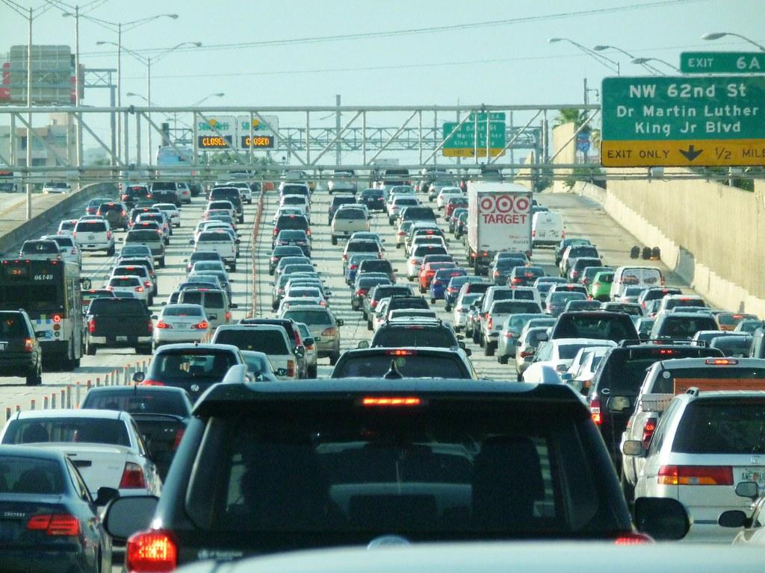
Project 3: Traffic Accidents in the US (Data Engineering)
By: Tasha Peeples, Deiva Ganabathy, Sara Simons, Jonathan Yang, and Samuel DeWitt

Slide 2
Dataset
Datasets sourced from NHTSA (National Highway Traffic Safety Administration) CRSS (Crash Report Sampling System) Accident Records for the year 2019, obtained via Kaggle.
Three separate .csv files were imported: one containing data regarding each accident on file, one detailing the people involved, and a third listing vehicle information for all involved parties.
Examples of provided data include: demographics, accident location, time, weather, severity of injuries, involvement of alcohol, and vehicle make/models.

Slide 3
Data Cleaning and ETL Performed
Two of our .csv files were initially larger than GitHub’s 100mb file limit.
As all three .csv files were sorted in the same order (by date of accident) this issue was resolved by trimming each file down to the same Case Number until all three were below the 100mb threshold (still WELL over 100 records!).
Most of the data in each .csv was present in 2 columns; one for the text value and another for an associated integer value (ex. there are two columns for the Make of vehicle, one which displays Ford, Dodge, etc., and one which displays 12, 7, etc.).
We decided to pull in columns containing text values where appropriate and left out any associated duplicate columns when building our clean dataframes.
Some further culling of columns was required to merge all three data frames together into one .csv file for exporting and upload to GitHub.
This makes for a more manageable dataset, focusing on the metrics we deemed most important.

Slide 4
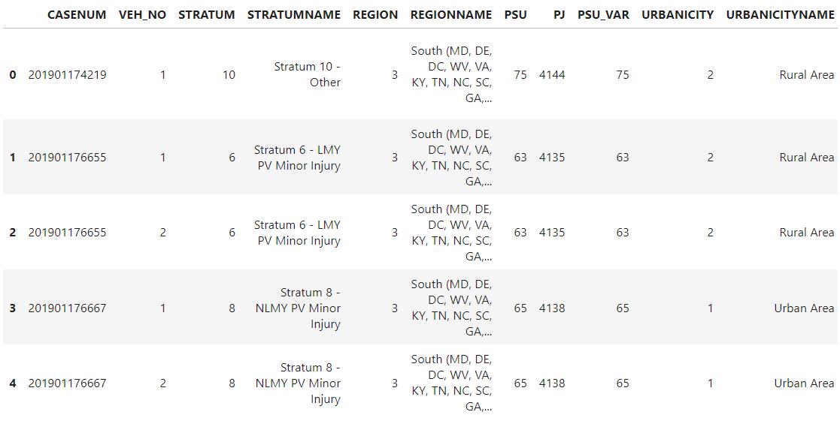
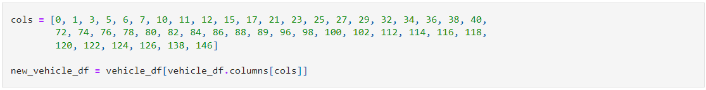
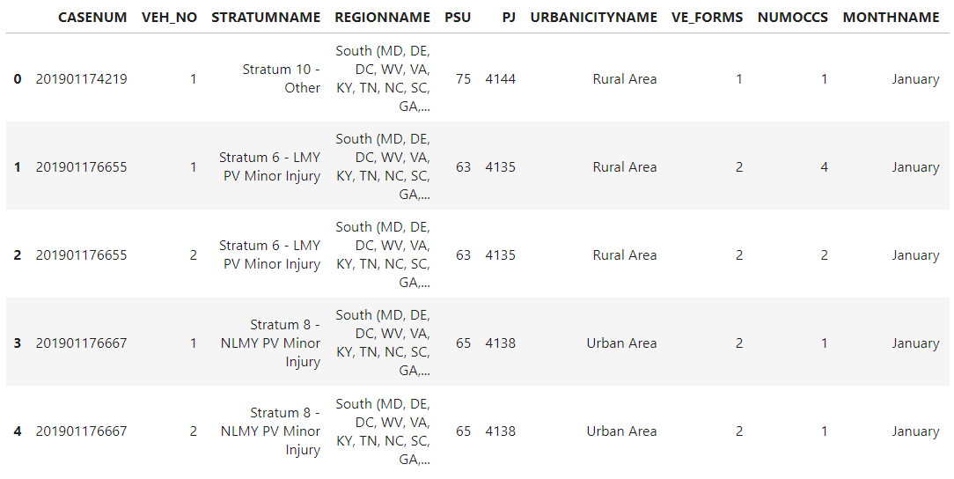
Example of ETL Performed
Selecting columns to remove duplicates
Cleaned dataframe
Columns to be removed

Slide 5
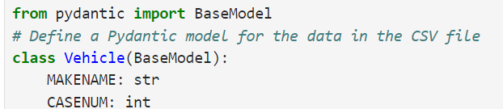
Data Validation Library - Pydantic
Pydantic allows to define data models and it automatically validates input data against these models

Slide 6
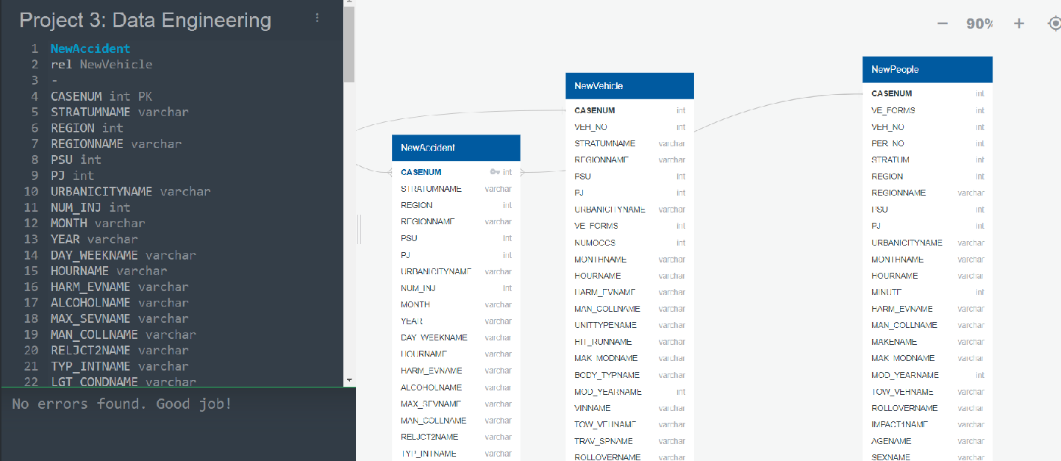
ERD - Free Data Diagram Tool

Slide 7
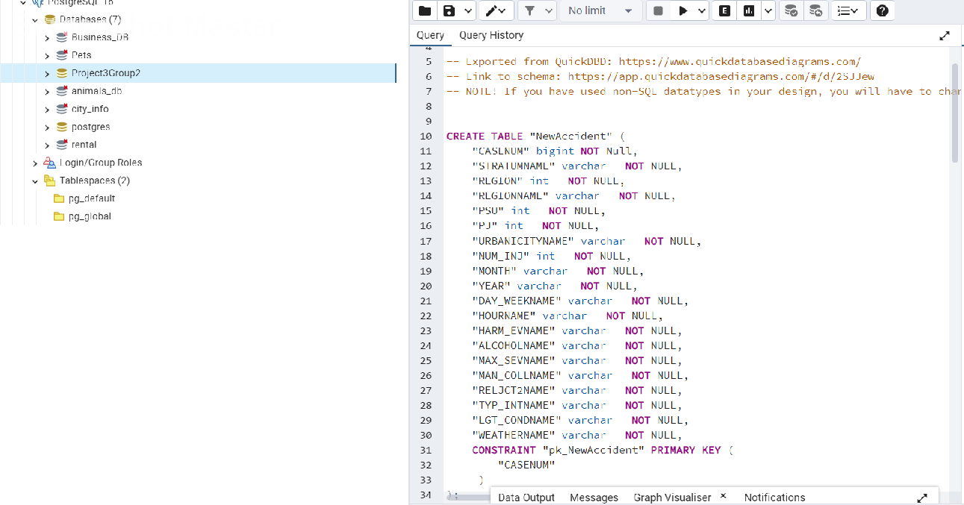
ERD Import

Slide 8
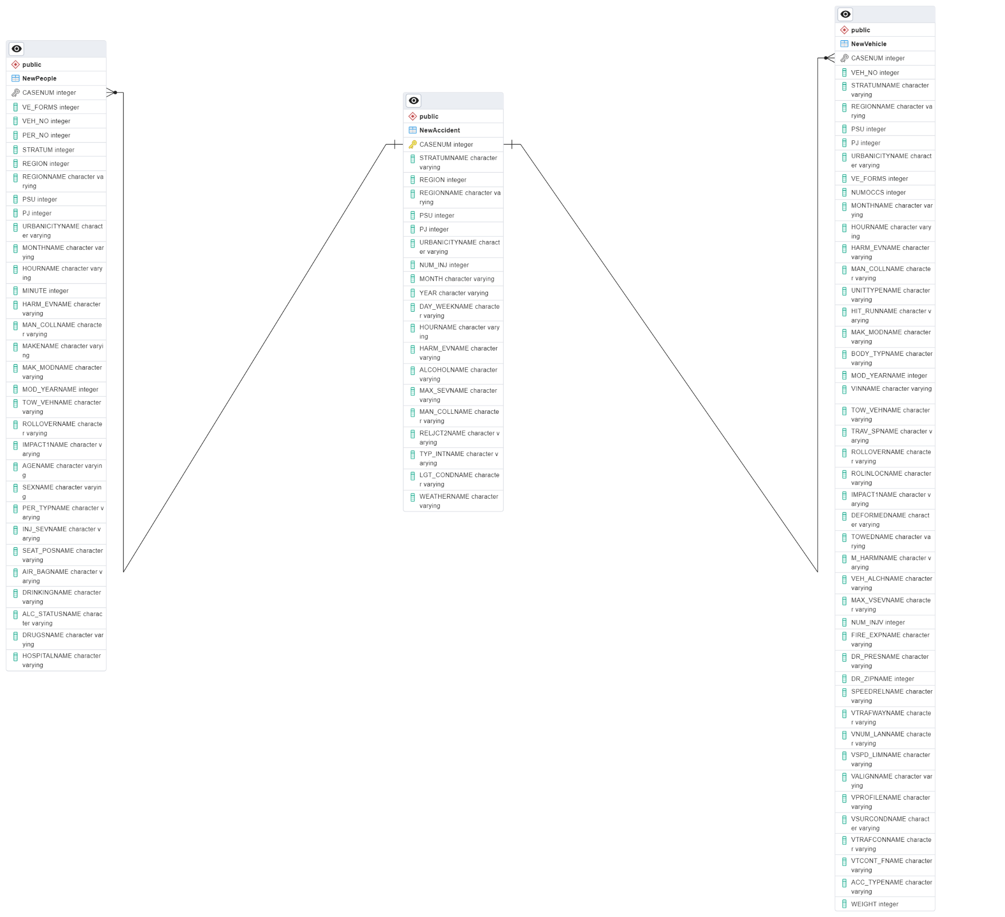
ERD - PostgreSQL

Slide 9
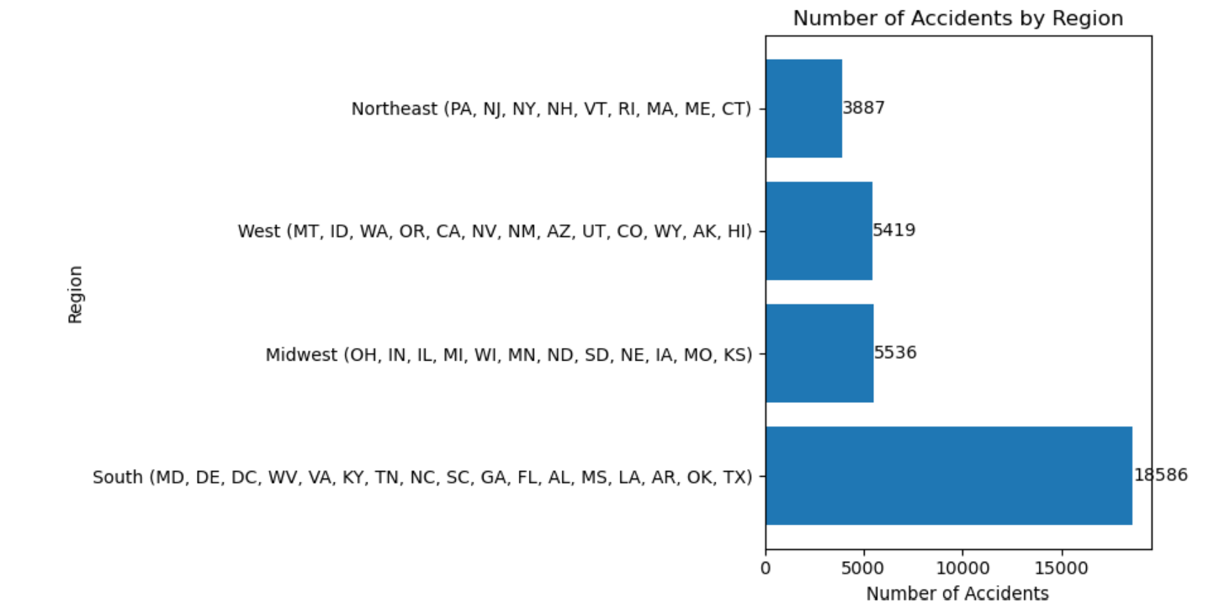
Data Analysis: Accidents by Region

Slide 10
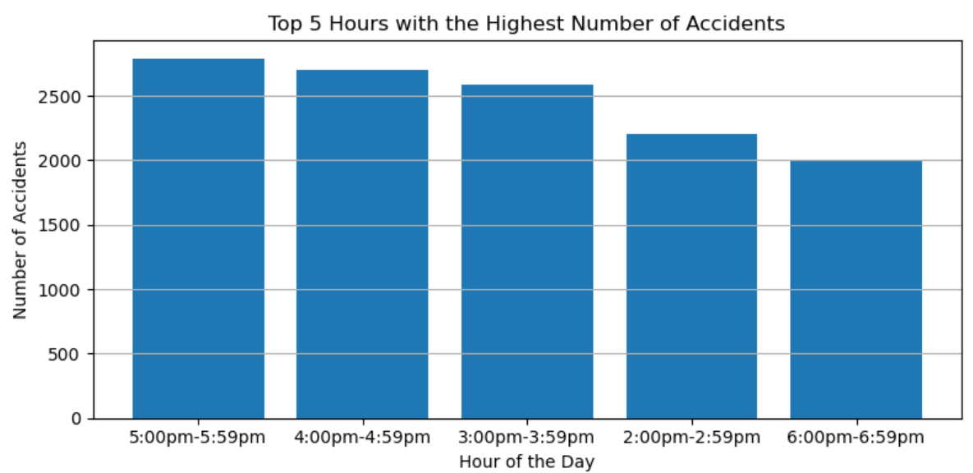
Does time influence the number of accidents?

Slide 11

Seaborn
Seaborn is a Python library that works off the foundations laid by MatPlotLib in order to provide more options when creating data visualizations. The following visualizations were created using Seaborn’s seaborn.histplot function.

Slide 12
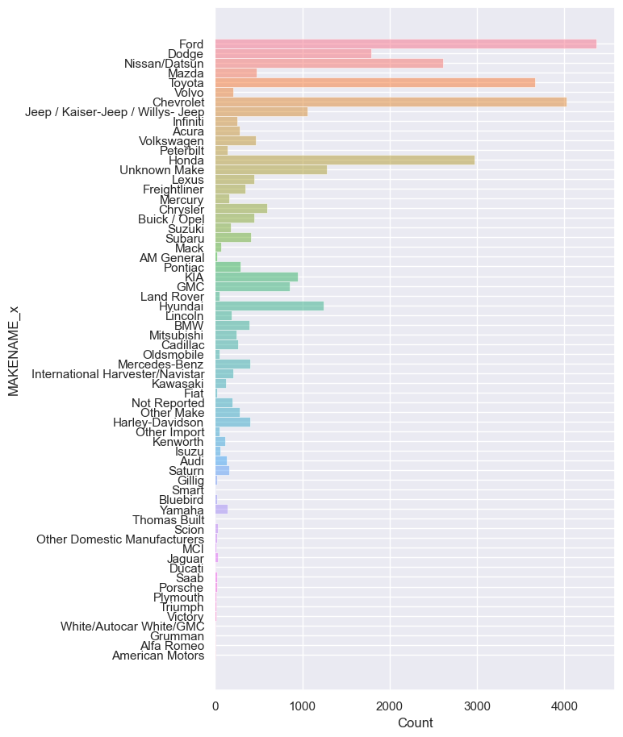
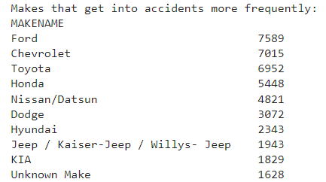
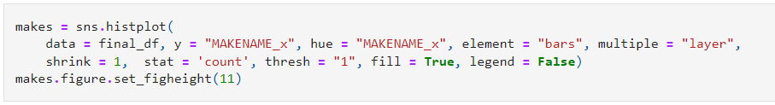
Accidents by Make

Slide 13
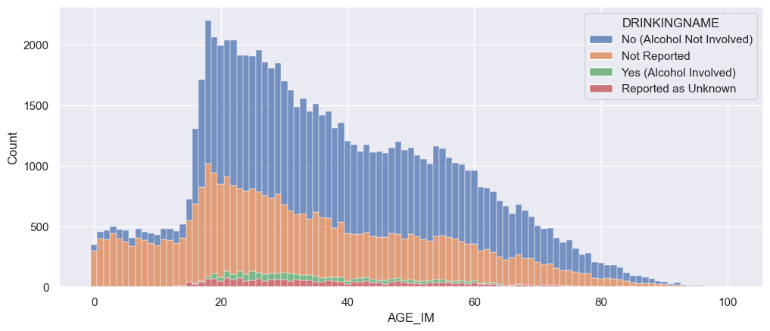
Accident Frequency by Age, Overlayed with Alcohol Involvement

Slide 14
Conclusions
1) Which region of the US has the worst drivers?
- The Southern Region had the most car accidents in 2019.
2) Does time influence the number of accidents?
- Yes, there are clear indicators showing certain hours with a high rate of accidents.
- 3:00 pm - 6:00 pm were the top three most common intervals.
3) Which Makes get into accidents more frequently?
- Ford Vehicles were the top Make for accidents in 2019.
4) Severity proportion and accident frequency for each region?
- The most common severity in all four regions was “No Injury”

Slide 15
Limitations
1) Only used data from 2019.
2) Didn’t investigate every detail regarding all the accidents
Ex: Weather, actions before accident, # of people/vehicles involved, and etc.
3) Not all accidents were reported, and some were reported with incomplete information.
4) Differences in population and population density per region.

Slide 16
Sources
Data: https://www.kaggle.com/datasets/jonbown/us-2020-traffic-accidents
Analytical User Manual for the dataset: https://crashstats.nhtsa.dot.gov/Api/Public/ViewPublication/813436
Seaborn: https://seaborn.pydata.org/index.html

Slide 17
QUESTIONS?

